Slide 1

EPA 400:
Protective Action Guide
Dr. Marianno
Emergency Response Dose Assessment

Slide 2
Reading Assignment
Read Chapters 3,4 and 5
EPA 400 is in this weeks module Resource Section

Slide 3
Definitions

Slide 4
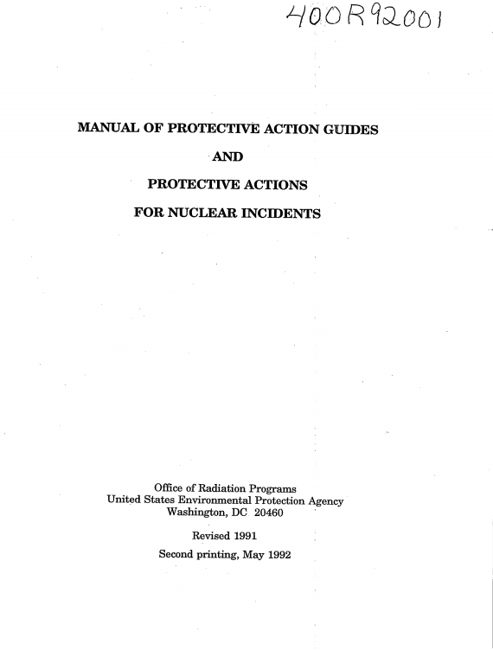
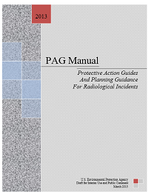
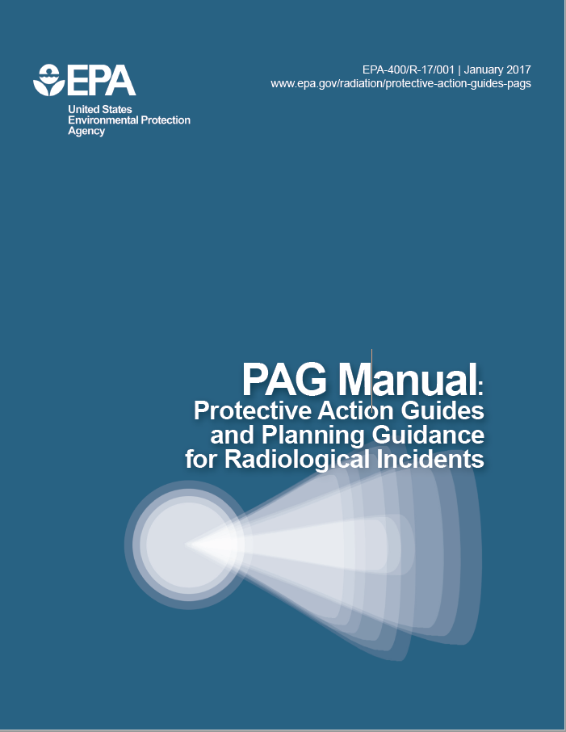
ICRP 26/30
ICRP 60

Slide 5
Differences-Inputs and Legal Basis
Organizational Structure changed
  Kept 3 phases but consolidated action plans
New PAG has input from: FRPCC, DOE, DOD, FEMA, NRC, HHS, CDC, FDA, USDA, DOL
Legal Basis: 44 CFR 351 & Exec Order 12656

Slide 6
EPA 400 Accepts Unanticipated Improvements
EPA anticipates that radiological assessment methods will be periodically updated as improved models and methods become available. Therefore, readers are encouraged to review the current version of the FRMAC Assessment Manual to understand the most current, default radiological assessment methods. For simplicity, specific organ dose thresholds for evacuation and sheltering were removed from the Manual.

Slide 7
Differences in PAG’s

Slide 8
Phases

Slide 9
Phase 1: Emergency Phase
Exposure pathways for early phase:
Define radiation exposure areas

Slide 10
Phase 1: PAGs
Principle Actions: Evacuation, Shelter-In-Place (SIP) and Admin of Potassium Iodide
SIP and Evacuation:
Supplementary admin of KI:

Slide 11
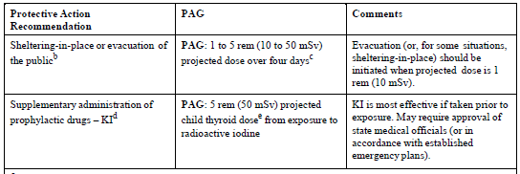
Phase 1: Evacuation vs SIP
Evacuation
SIP
NEED TO TAKE INTO ACCOUNT EMERGENCY RESPONDER CAPABILITY IF RECOMMENDING EVACUATION

Slide 12
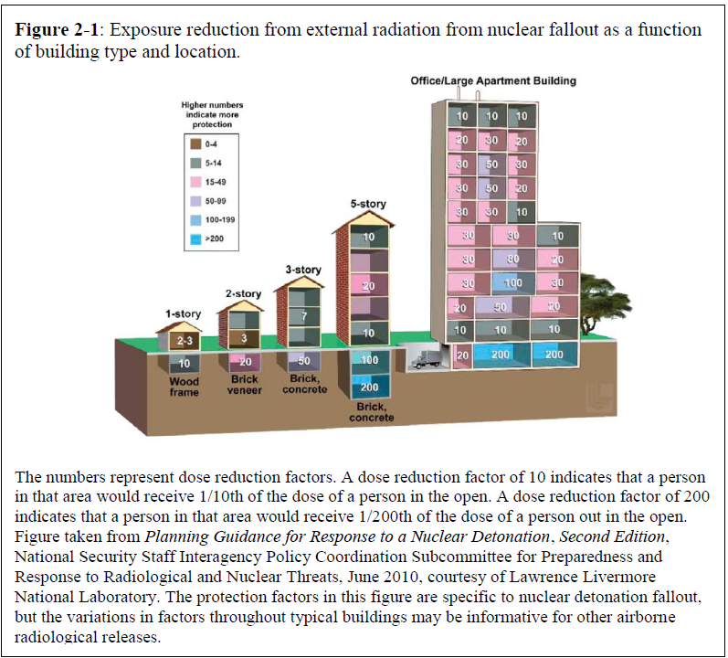
Phase 1: Pros of SIP
Building and cars having shield coefficients.

Slide 13
Phase 1: KI Administration
Taken before exposure and only effective against radioiodine
FDA Recommends:

Slide 14
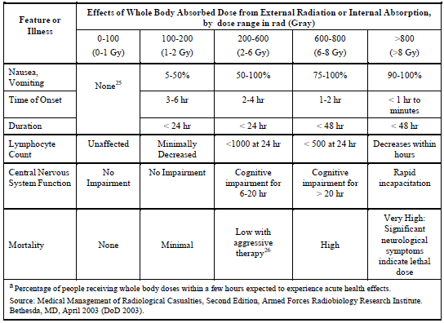
Phase 1: Response Workers
Maintain ALARA
Follow 5, 10, 25 program
“Time-sensitive mission critical” activities
  NCRP 165: Responding to a Radiological or Nuclear Terrorism Incident: A Guide for Decision Makers
Also follow OSHA 29CFR, EPA 40CFR, NRC 10CFR 20, and DOE 10CFR 835

Slide 15
Phase 2 Intermediate Phase
Used when source and releases are under control and environmental measurements are available for decisions
Exposure Pathways:

Slide 16
Phase 2: PAGs
Principle Protective Actions:
Relocation is most effective but highly disruptive

Slide 17
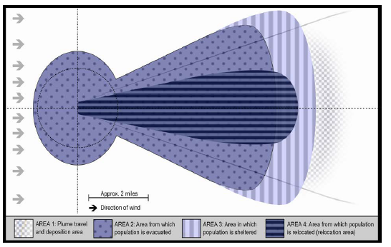
Phase 2: Relocation
Relocation can be refined due to knowing environmental factors (Plume direction) and source size (> 2 rem)
Relocation from Phase 1 and 2 creates 3 groups:
  People who have already been evacuated
  People who were not previously evacuated, but should
  People who have been evacuated but reside outside of relocation, so may return home

Slide 18
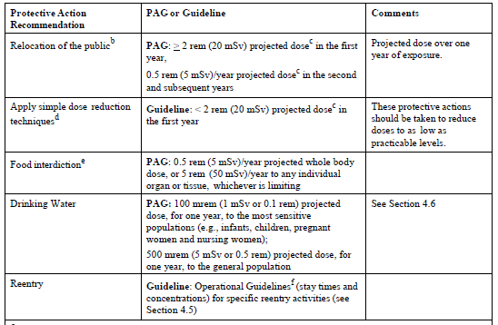
Phase 2 PAGs

Slide 19
Phase 2: Priorities

Slide 20
Phase 3
Long term clean up process
Used for a nationally significant radiological incident
  NPP, RDD, IND
PAGs will not be used to guide restoration of areas impacted
Balance of restoring business, reducing radiation risks, radiation decay and managing contaminated waste

